Slide 1
Chapter 4 Control Statements: Part I

Slide 2
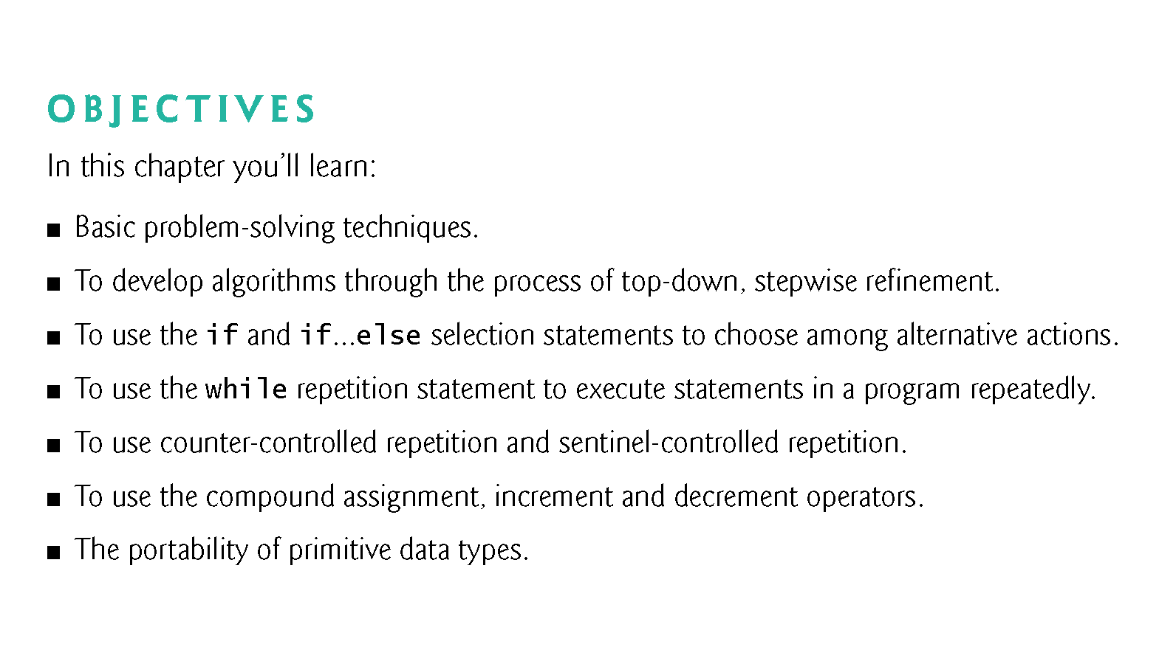

Slide 3
4.1 Introduction
This chapter introduces
The if, if…else and while statements
Compound assignment, increment and decrement operators
Portability of Java’s primitive types

Slide 4
4.2 Pseudocode
Particularly useful for developing algorithms that will be converted to structured portions of Java programs.

Slide 5
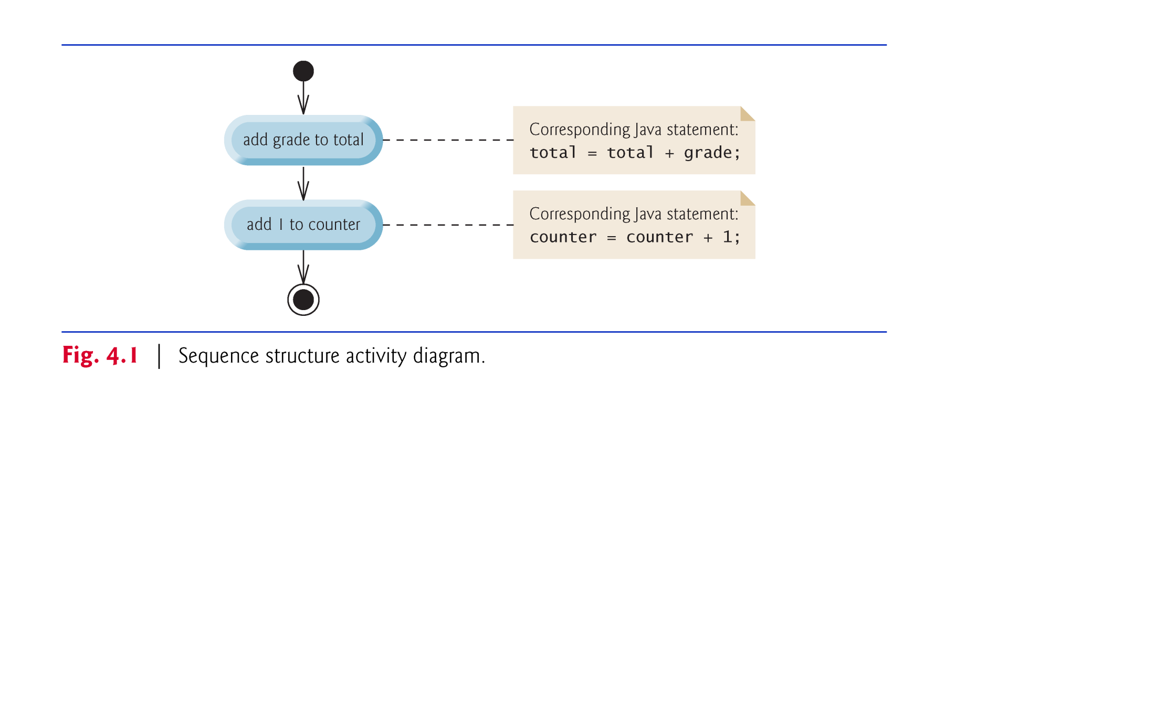
4.3 Control Structures
Sequence structure

Slide 6
4.3 Control Structures (Cont.)
Three types of selection statements.
if statement:
Single-selection statement
if…else statement:
Double-selection statement
switch statement
Multiple-selection statement

Slide 7
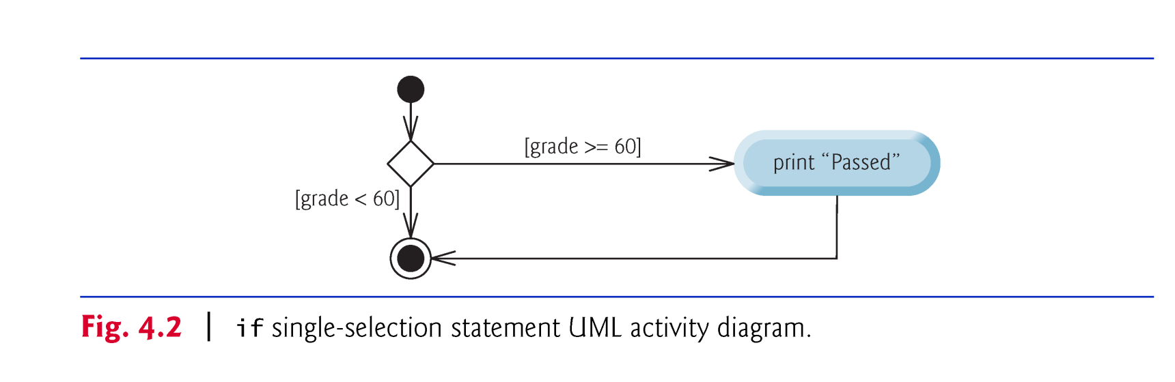


Slide 8
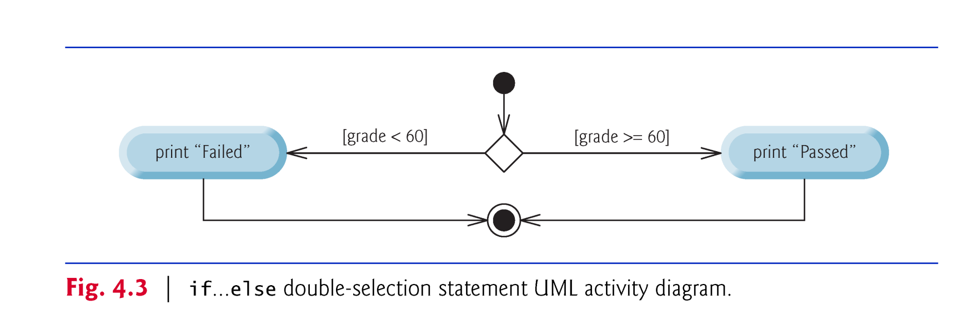
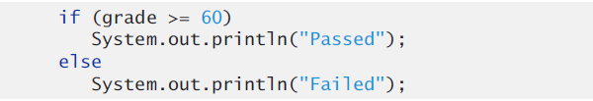

Slide 9
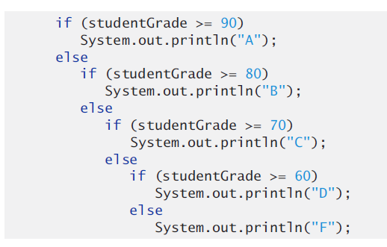
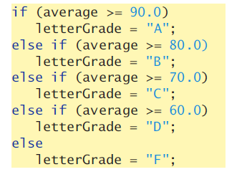
Nested if…else Statements

Slide 10
4.3 if…else Double-Selection Statement (Cont.)
Conditional operator (?:)—shorthand if…else.
Ternary operator (三元运算符 takes three operands)
Example:
System.out.println( studentGrade >= 60 ? "Passed" : "Failed" );
Evaluates to the string "Passed" if the boolean expression studentGrade >= 60 is true and to the string "Failed" if it is false.

Slide 11
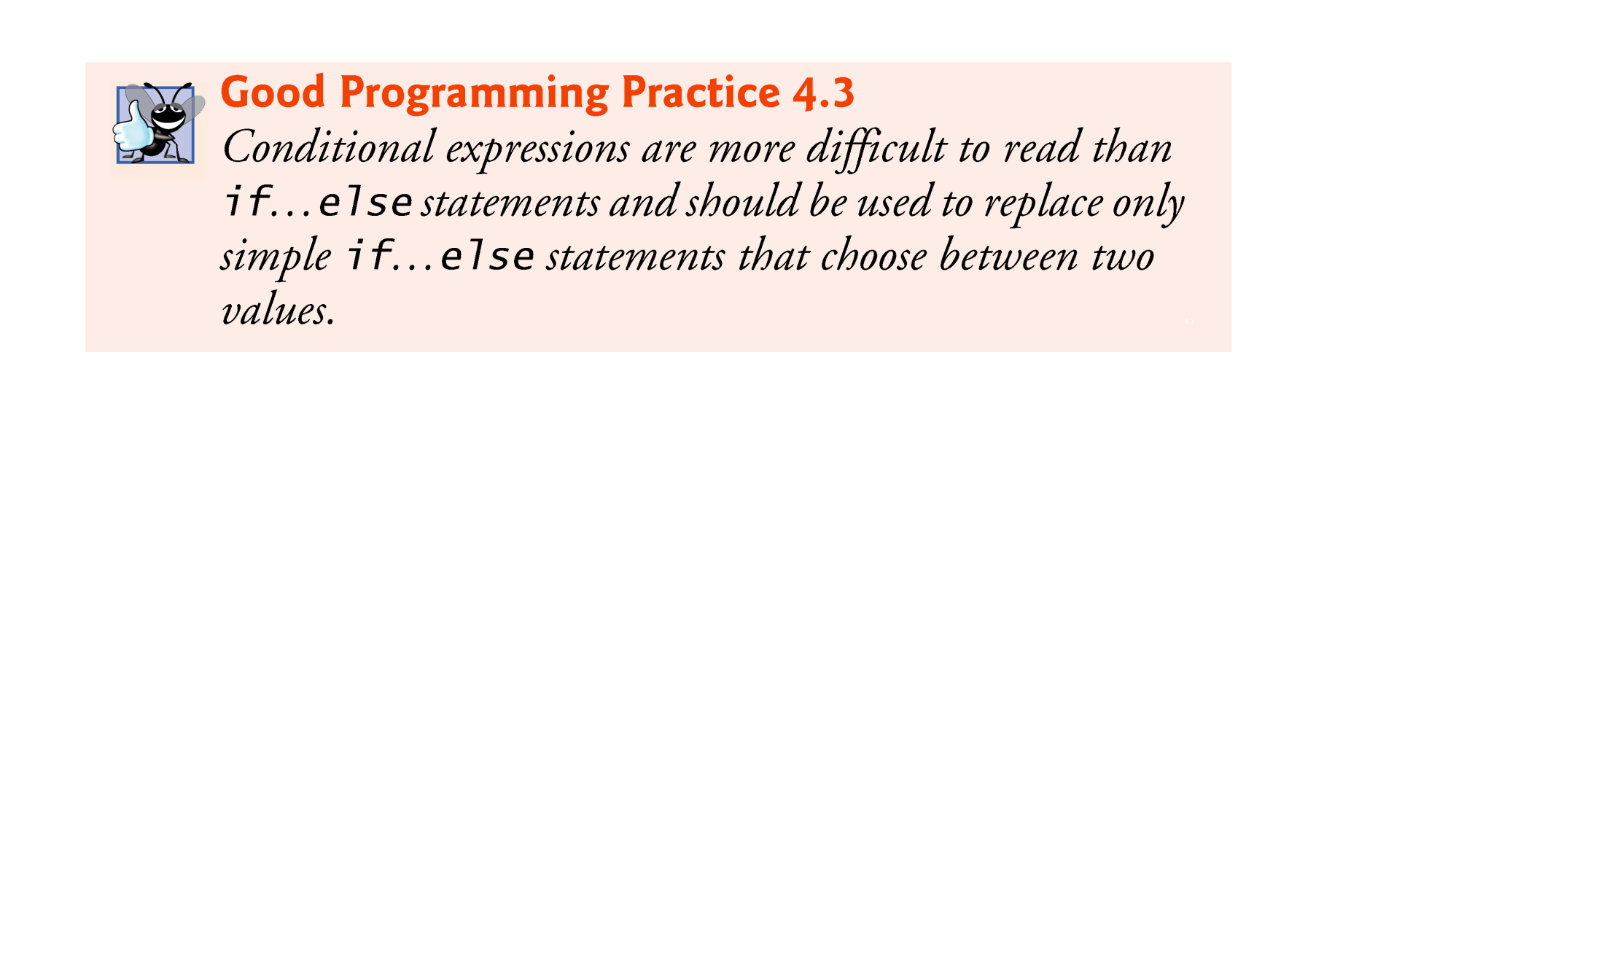

Slide 12
4.3 Control Structures (Cont.)
while and for statements perform the action(s) in their bodies zero or more times
The do…while statement performs the action(s) in its body one or more times.

Slide 13
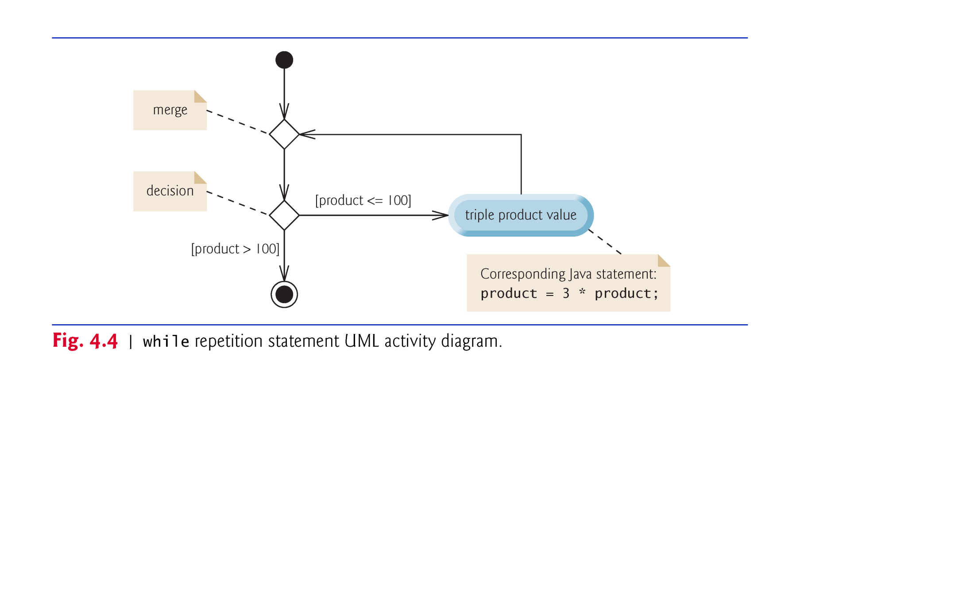
while
while ( product <= 100 ) product = 3 * product;

Slide 14
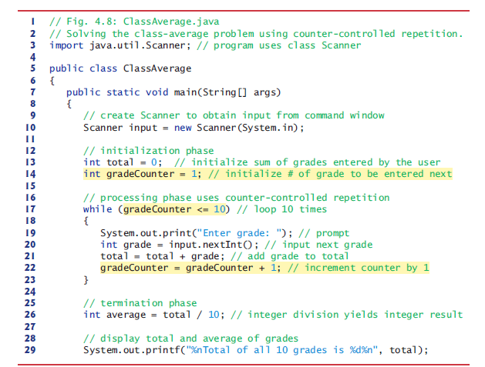

counter-controlled repetition

Slide 15
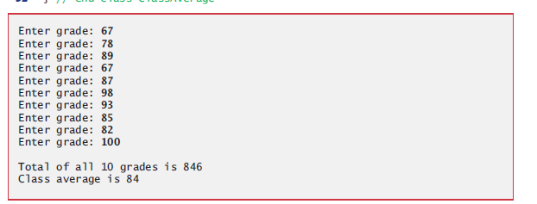

Slide 16
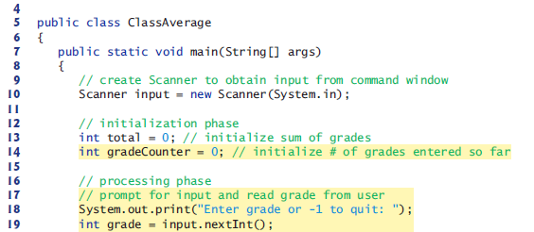
Sentinel-controlled repetition

Slide 17
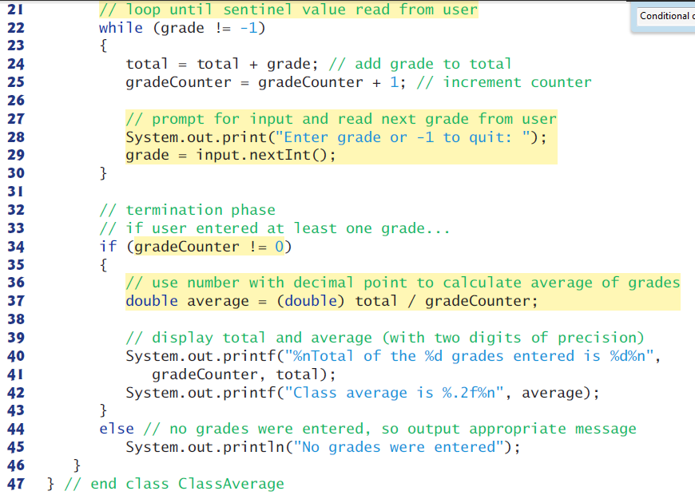
Sentinel-controlled repetition

Slide 18
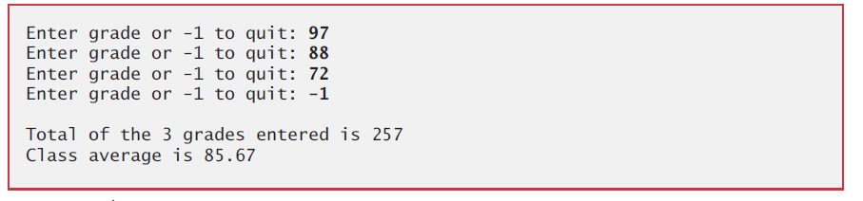

Slide 19
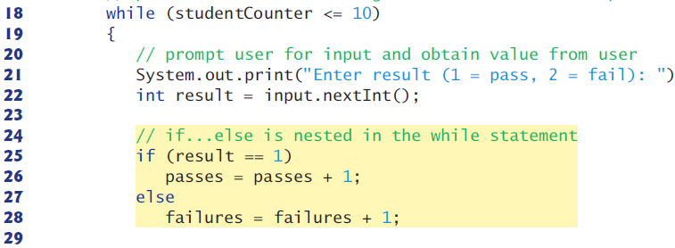

Nested Control Statements
Control statements can be stacked on top of one another

Slide 20
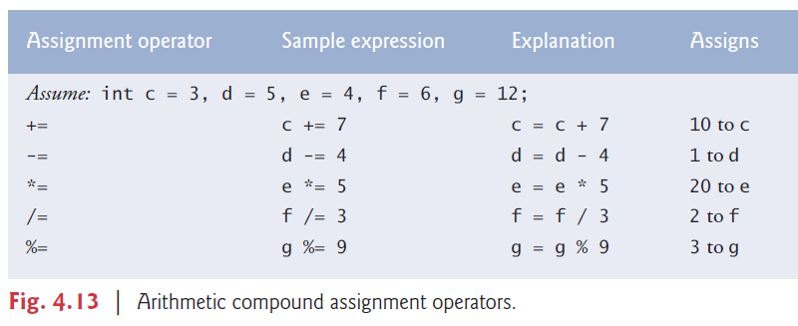
4.4 Compound Assignment Operators

Slide 21

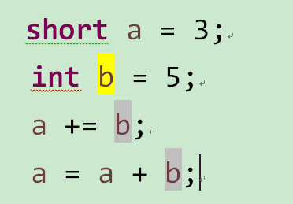

Is “a+=b” same as “a =a + b” ?
$$√$$
Type mismatch: cannot convert from int to short

Slide 22
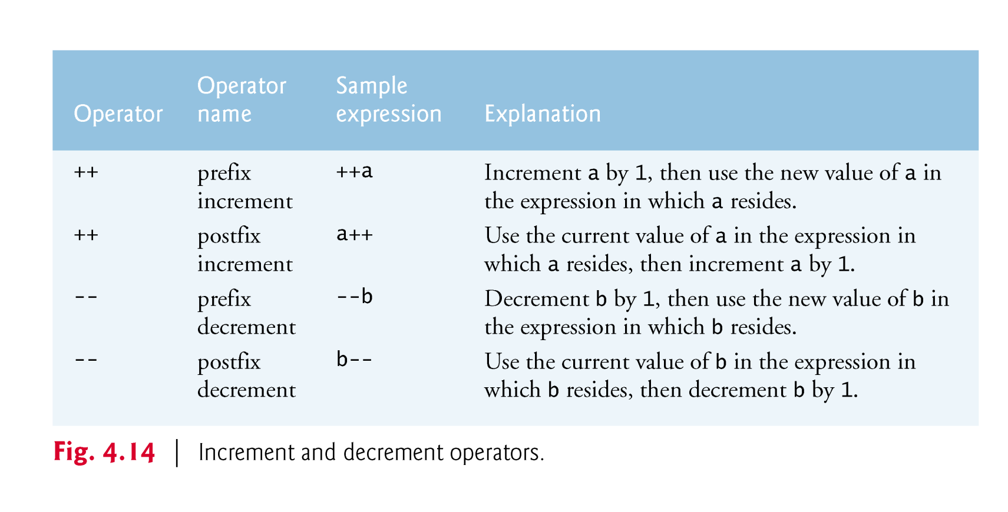
4.5 Increment and Decrement Operators

Slide 23
4.6 Primitive Types
Appendix D lists the eight primitive types in Java.
Java requires all variables to have a type.
Java is a strongly typed language.
Primitive types in Java are portable across all platforms.
Instance variables of types char, byte, short, int, long, float and double are all given the value 0 by default. Instance variables of type boolean are given the value false by default.
Reference-type instance variables are initialized by default to the value null.

Slide 24
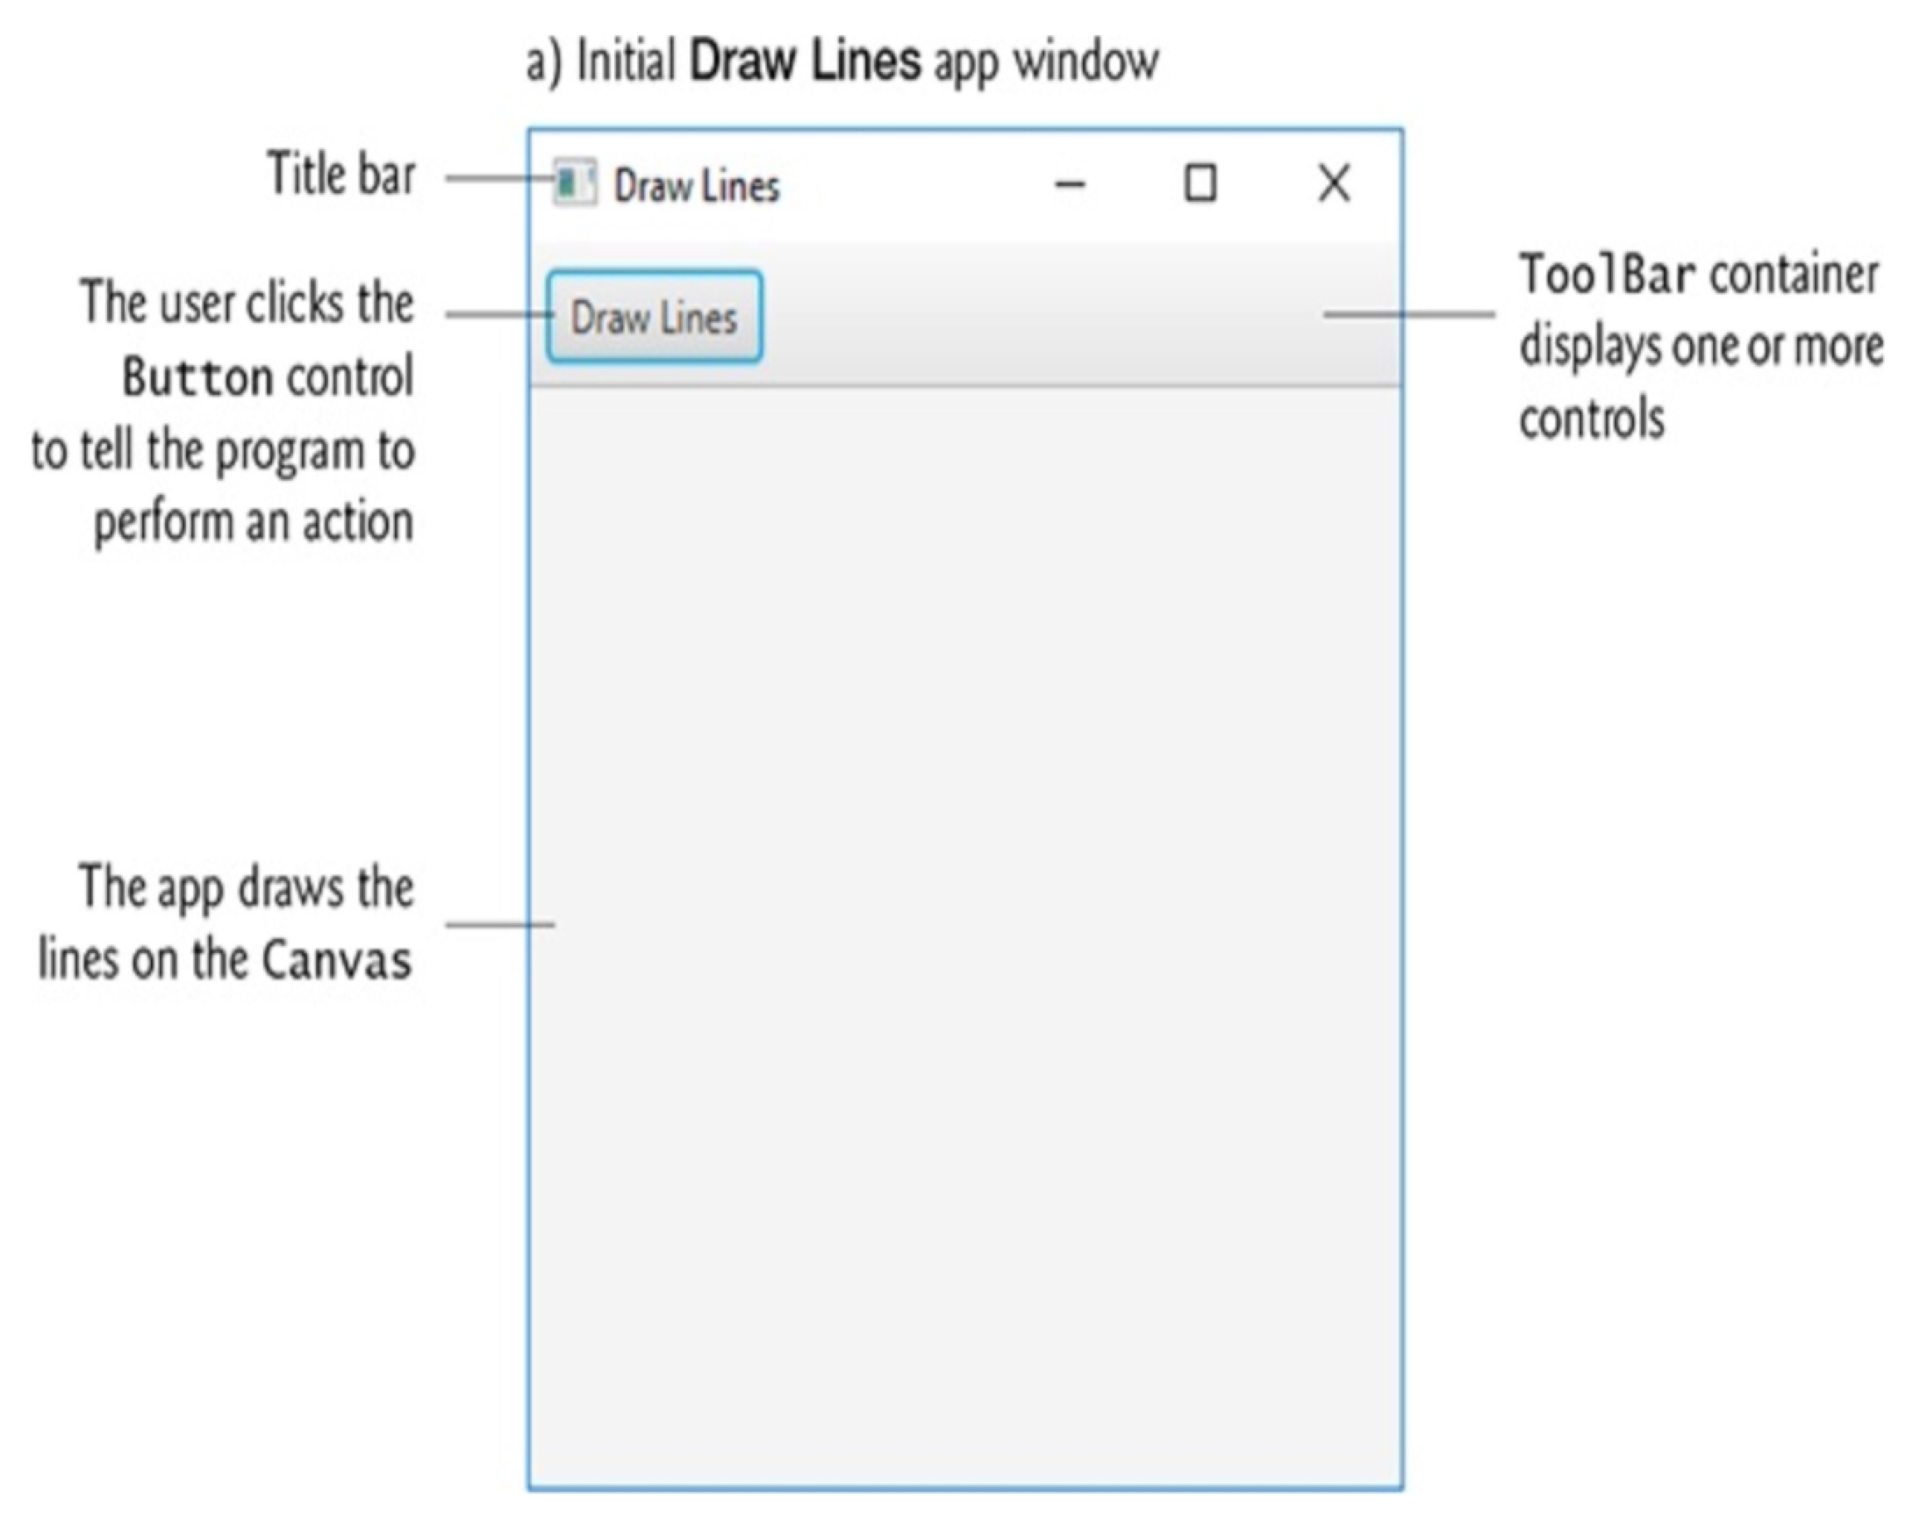
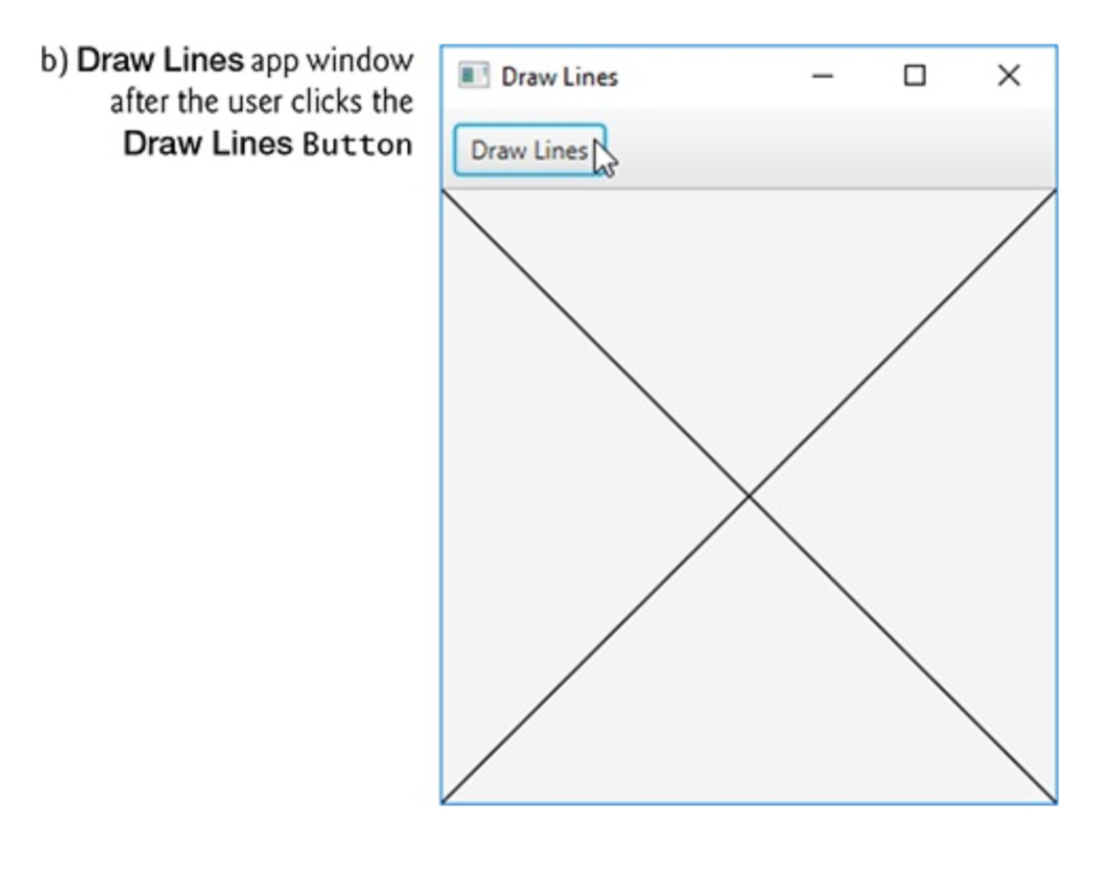
4.7 (Optional) GUI and Graphics Case Study: Event handling; Drawing Lines

Slide 25
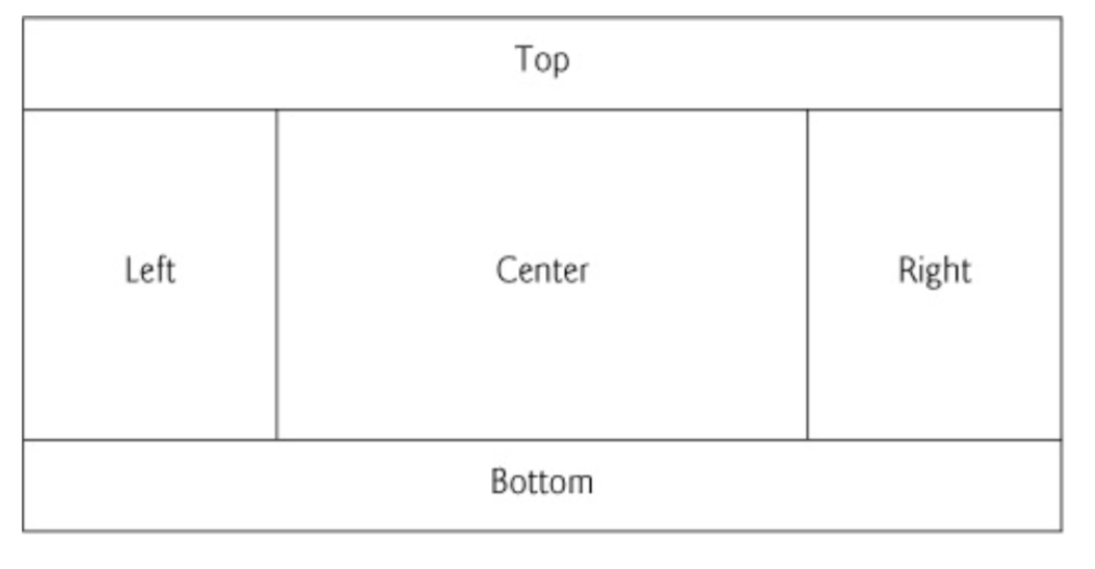
4.7 (Optional) GUI and Graphics Case Study: Event handling; Drawing Lines (Cont.)
Controls
Canvas control—a rectangular area in which you can draw.
BorderPane layout container arranges controls into one or more of the five regions.

Slide 26
4.7 (Optional) GUI and Graphics Case Study: Event handling; Drawing Lines (Cont.)
Controls
ToolBar layout container
ToolBars typically organize multiple controls at a layout’s edges, such as in a BorderPane’s top, right,bottom or left areas.
ToolBar arranges controls horizontally by defult.
Initial ToolBar containing a Button – by default the Tool Bar is the full width of the BorderPane’s top area.

Slide 27
4.7 (Optional) GUI and Graphics Case Study: Event handling; Drawing Lines (Cont.)
Design the GUI
Drag-and-drop a BorderPane from the Library window’s Containers section onto Scene Builder’s content panel.
Drag-and-drop a ToolBar layout container to the BorderPane’s top region.
double-click the Button to edit its text
Drag-and-Drop a Canvas from the Scene Builder Library’s Miscellaneous section to the BorderPan’s center area.
Width ,Height, Pref Width, Pref Height
File > Save

Slide 28
4.7 (Optional) GUI and Graphics Case Study: Event handling; Drawing Lines (Cont.)
For the ToolBar, set the following properties:
text——Draw Lines
For the Canvas, set the following properties:
Width——300
Height——300
For the BorderPane, set the following properties:
Pref Width，Pref Height——USE_COMPUTED_SIZE

Slide 29
4.7 (Optional) GUI and Graphics Case Study: Event handling; Drawing Lines (Cont.)
Preparing to Interact with the GUI Programmatically
JavaFX GUI controls also are objects that you can interact with programmatically. For GUIs created in Scene Builder, JavaFX creates the controls for you when the app begins executing.

Slide 30
4.7 (Optional) GUI and Graphics Case Study: Event handling; Drawing Lines (Cont.)
Preparing to Interact with the GUI Programmatically
Specifying the App’s Controller Class
When you launch a JavaFX app with an FXML GUI, the JavaFX runtime:
creates the GUI,
creates an object of the controller class that you specified in Scene Builder,
initializes any of the controller object’s instance variables that you specified in Scene Builder, so they refer to the corresponding control objects, and
configures any of the controller object’s event handlers that you specified in Scene Builder, so that they’ll be called when the user interacts with the corresponding control(s).

Slide 31
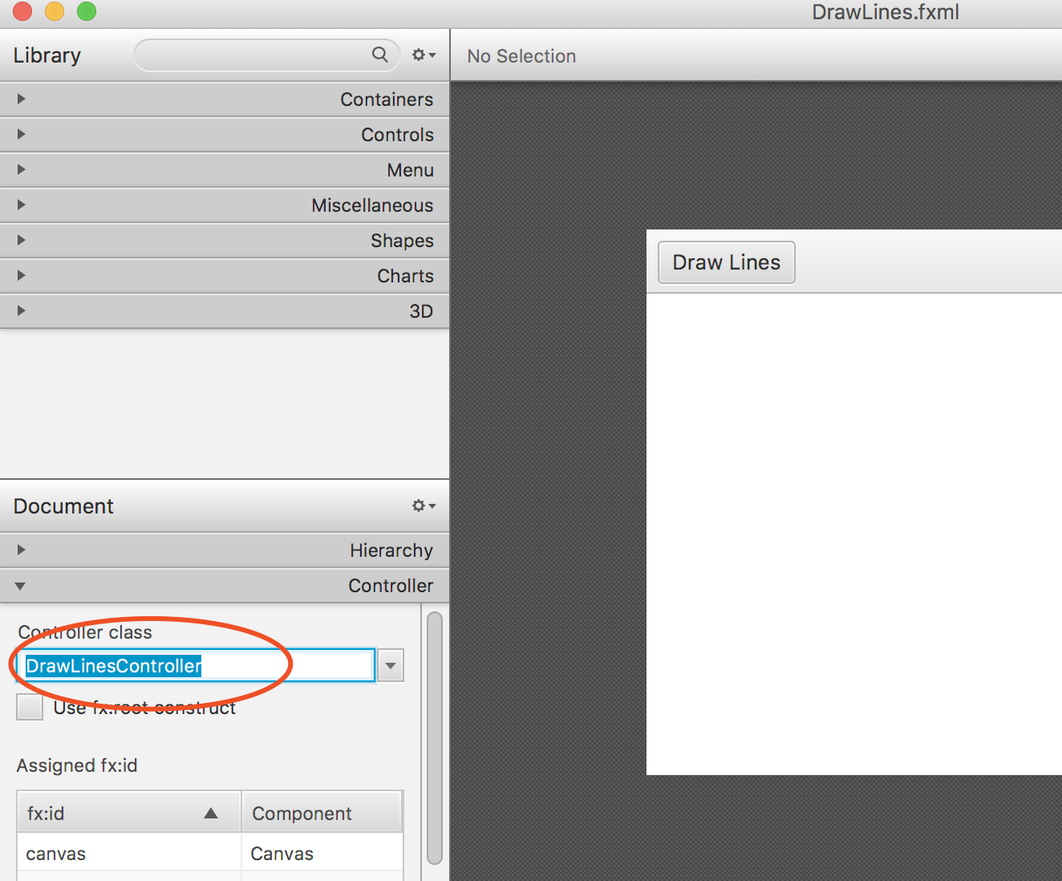
4.7 (Optional) GUI and Graphics Case Study: Event handling; Drawing Lines (Cont.)
Preparing to Interact with the GUI Programmatically
Specifying the App’s Controller Class
To specify the controller class’s name

Slide 32
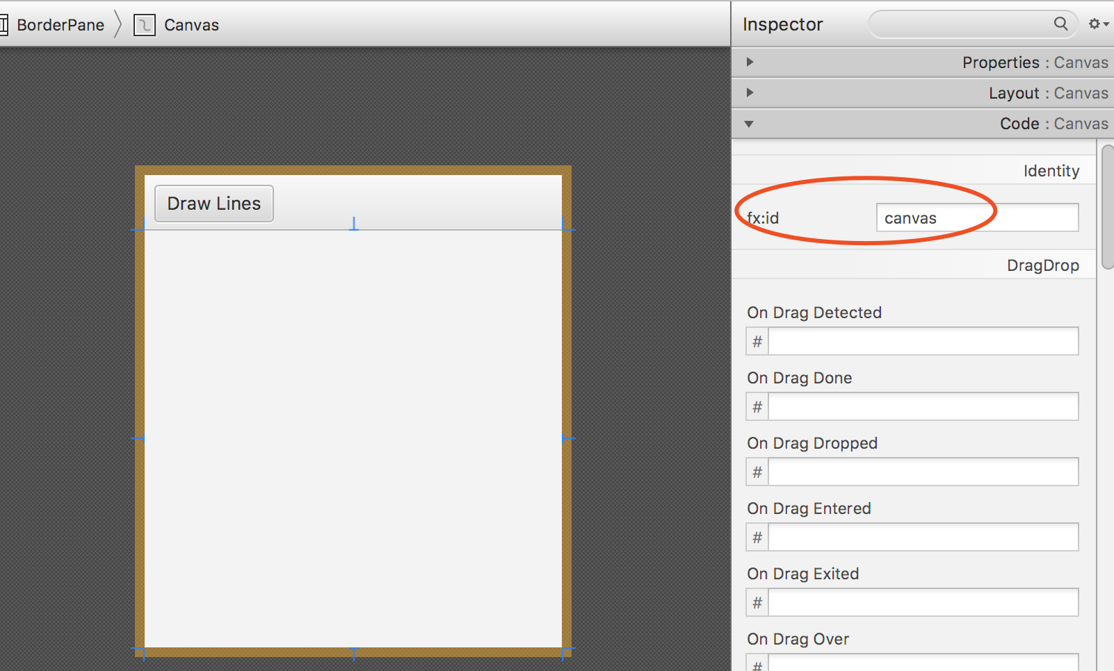
4.7 (Optional) GUI and Graphics Case Study: Event handling; Drawing Lines (Cont.)
Preparing to Interact with the GUI Programmatically
2. Specifying the Canvas’s Instance Variable Name
A control’s fx:id property specifies the instance variable’s name—when the app begins executing, JavaFX initializes the instance variable with the corresponding control object.

Slide 33
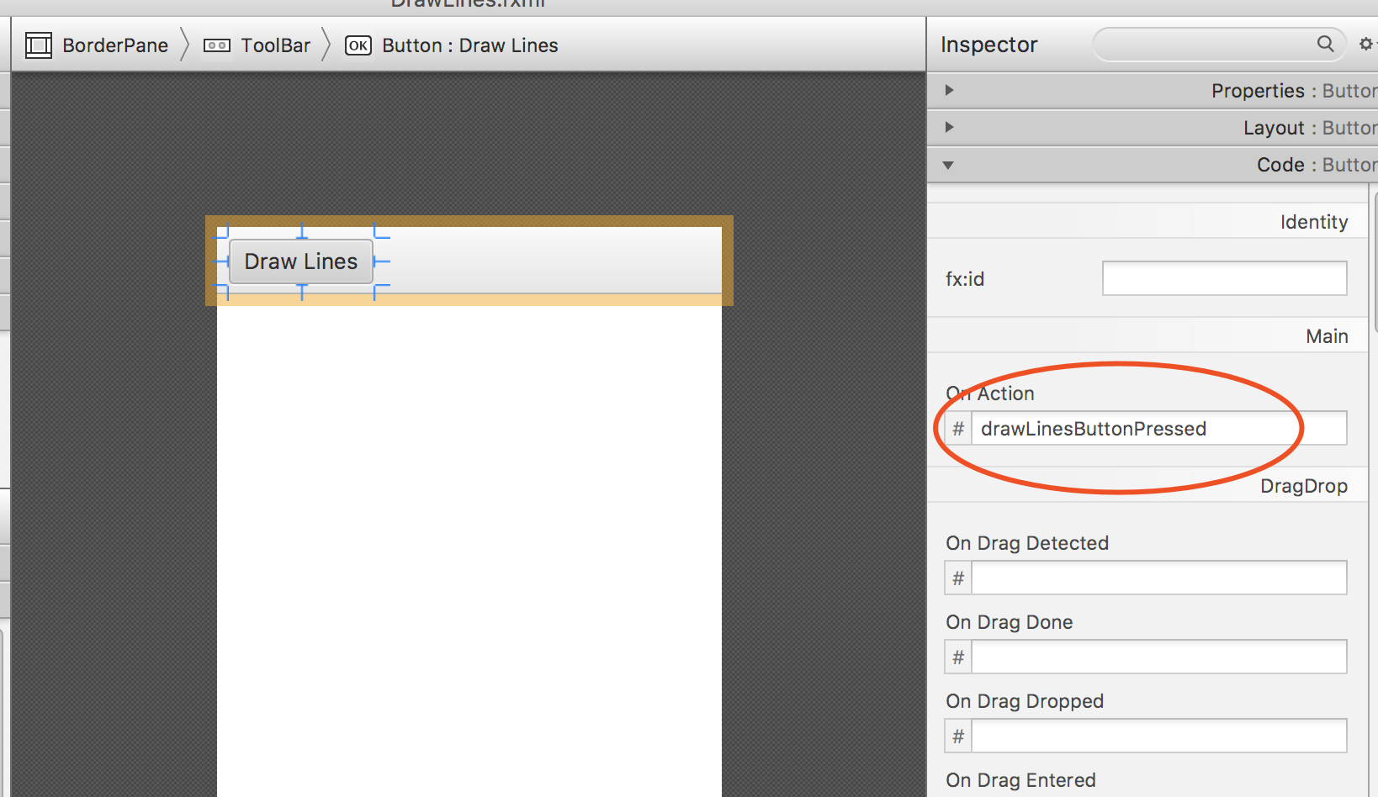
4.7 (Optional) GUI and Graphics Case Study: Event handling; Drawing Lines (Cont.)
Preparing to Interact with the GUI Programmatically
3. Specifying the Button’s Event-Handler Method
An event handler is a method that’s called in response to a user interaction.
The method is called by the JavaFX runtime on an object of the controller class.

Slide 34
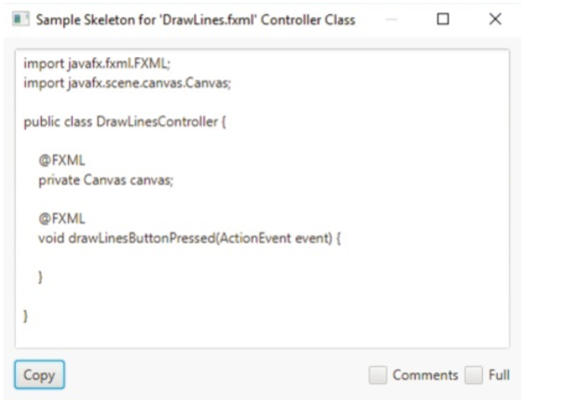
4.7 (Optional) GUI and Graphics Case Study: Event handling; Drawing Lines (Cont.)
Preparing to Interact with the GUI Programmatically
4. Generating the Initial Controller Class
Select View > Show Sample Controller Skeleton to display the class
create a Java source-
code file named DrawLinesController.java in the same folder as DrawLines.fxml
paste the code into
that file and save the file. You can add the program’s logic into the file.

Slide 35
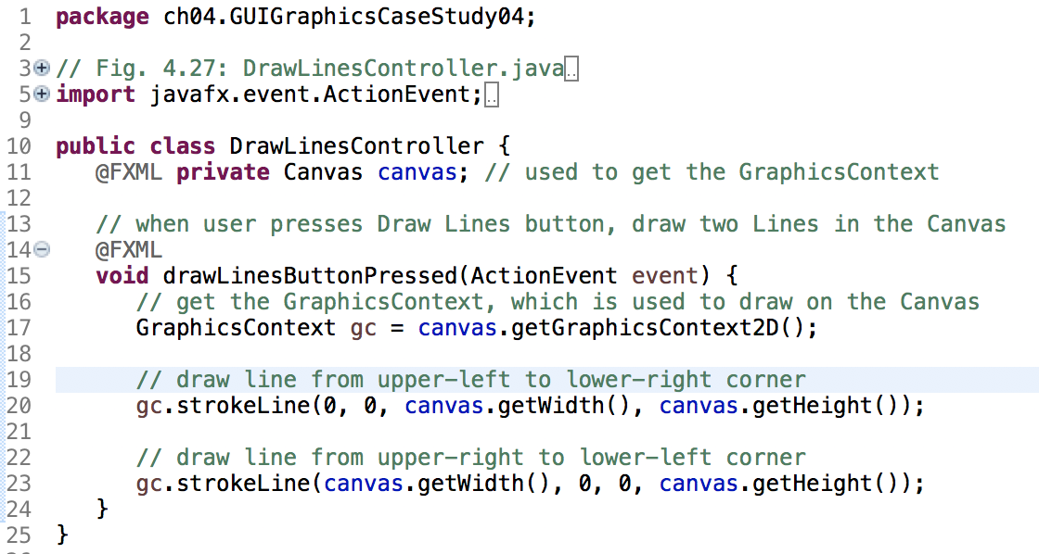
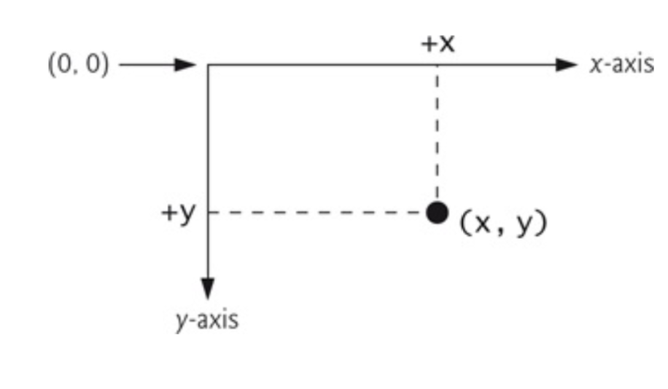

Slide 36
4.7 (Optional) GUI and Graphics Case Study: Event handling; Drawing Lines (Cont.)
Preparing to Interact with the GUI Programmatically
5. Generating the main-application class
The main-applicaiton class loads the app’s FXML file, creates the GUI then creates and configures the corresponding controller-class.
By convention, this class has the same base name as the FXML file (DrawLines in DrawLines.fxml).

Slide 37
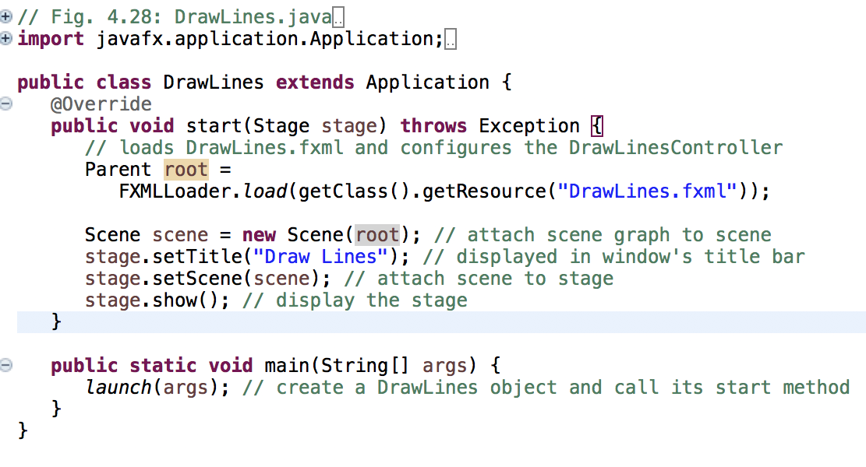
Notes:
javafx.stage.Stage类继承自javafx.stage.Window类，是JavaFX的顶层容器，代表一个舞台，当JavaFX程序被启动时，一个Stage就被自动创建，并通过参数传递给start()方法
java.stage.Stage相当于Swing的JWindow，是容纳java.scene.Scene的容器
javafx.scene.Scene容器算是很高层次的容器了
javafx.scene.Scene却是以树的形式组织的，每一个子组件就是它的一个节点；其根节点一般是Pane面板（如StackPane、BorderPane，就是一个根节点容器，可以容纳子节点，各子节点挂载在其上）
javafx.scene.Scene类是依附于javafx.stage.Stage类存在，是场景的意思；场景可以添加控件和其它用户接口结点——通过这种方法创建应用程序的用户界面；一个Stage必须至少有一个Scene

